Slide 1
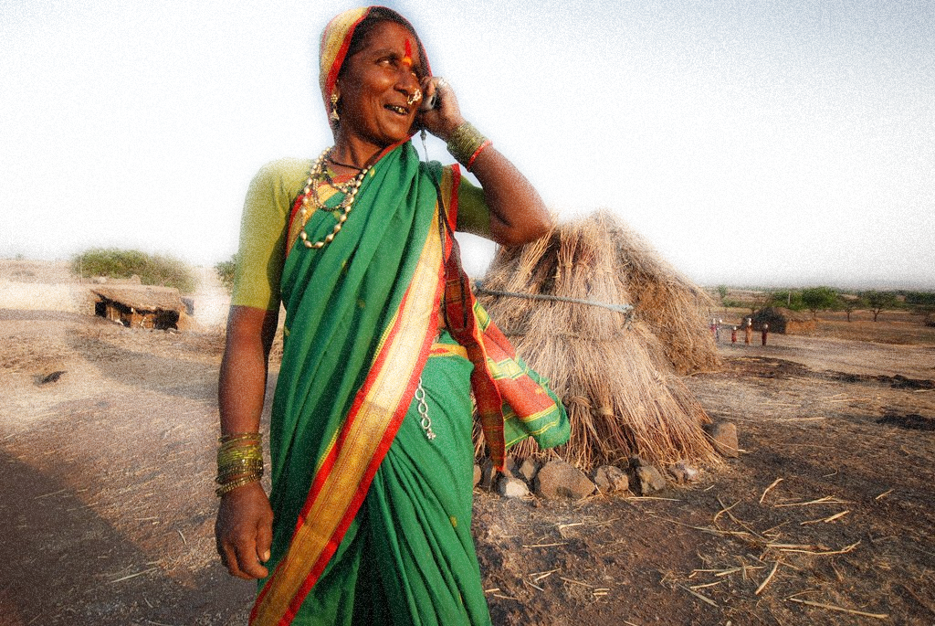

DATs for AGRICULTURE PRODUCITIVITY
August 19, 2019

Slide 2




India context: PRODUCTIVITY CHALLENGE and digital landscape
Rural advisory services
MOBILE weather-based advisory services: WORLD BANK INVESTMENT
Learning and way ahead FOR RURAL ADVISORY SERVICES
Notes:
© Copyright Showeet.com

Slide 3





India: Production – Productivity Paradox
India’s production, as a percentage of
world’s total production
India’s productivity compared to average world productivity
India
World
40.6%
Millets
71.7%
2.9%
Maize
54.1%
21.9%
Rice
83.6%
22.5%
Pulses
58.8%
12.8%
Wheat
91.2%
Source: FAOStat, 2017

Slide 4
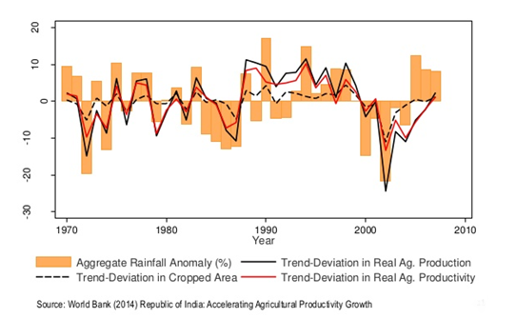
Variability with Rainfall: Productivity Challenge

Slide 5



Timely, Contextual and Dynamic Weather-Based Advisory:
A critical missing input
Product / Service
Features
Farmer:
End Consumer
Supply Side
Indian Meteorological Department: Government
Agriculture Universities issue advisories
Disseminated primarily through Radio / TV
Uni-directional information flow
Macro-knowledge (District-level)
Asynchronous communication (not real-time)
Twice a week
Widening knowledge gap on modern technologies (advisories)
Need for more real-time, localized and dynamic info.: climate change shocks

Slide 6
Agromet-Advisory (Sample)

Slide 7

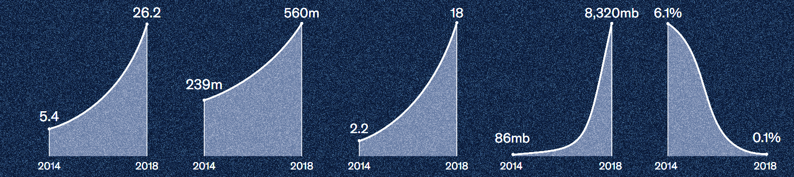
But, the digital and information landscape has changed..
1.2 bn people enrolled in the world’s largest unique digital identity programme
Number of smartphone
users per 100 people
Total number of
internet users
Monthly data consumption per unique connection
Monthly data price
(per 1gb as % of monthly GDP)
Source: Digital India, McKinsey Global Institute, Mar 2019

Slide 8

Mobile Assisted Rural Advisory Services

Slide 9
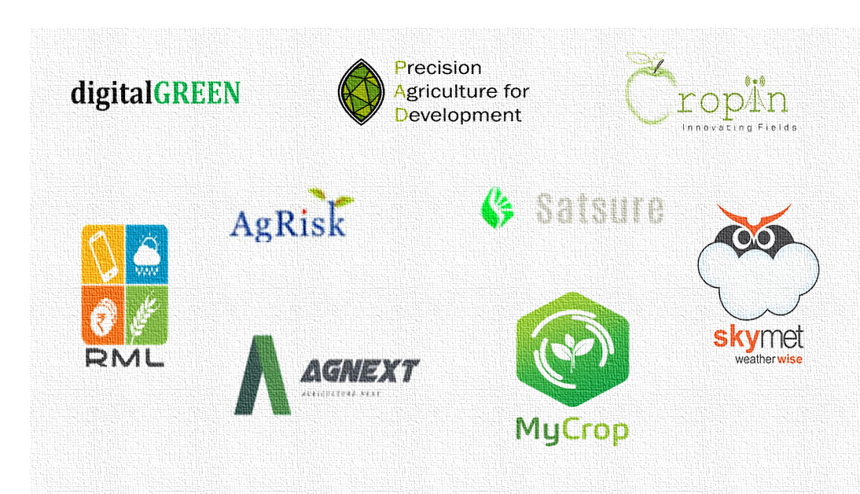

Landscape has enabled emergence of DAT enabled Customized Advisory Services
Potential to increase yields by 15-20%
(McKinsey Global Institute, Mar 2019)
Spectrum: Best Practices, Diagnostics, Predictive Analytics, Farm Management Solutions; Real-Time and Bi-Directional

Slide 10
Investment Example: Sustainable Livelihoods Adaption for Climate Change
TTL: Ms. Priti Kumar, Senior Agriculture Specialist (pkumar@worldbank.org)

Slide 11
Project Example: SLACC
Weather-Based Agro Advisory Services
2 States
200 Villages
8,000 Farmers
Public-Private Partnerships
Sustainable Livelihoods Adaption for Climate Change
Women CBOs
USD 8 million
Improve Adaptive Capacity of Rural Poor to Cope With Climate Variability and Change
Global Environment Facility Grant
Ongoing

Slide 12


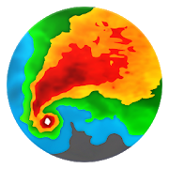

Farmer: Technology-Enabled Services
Current and Sort-Term Weather Forecast
POP Reminders
Forecast-based advisory
(Nutrient, Pest, Soil and Water Management)
Farmer Raised Alerts

Slide 13
Design Features
Collection of farmer-level data
Push and pull channel
Installation of automated weather stations and rain gauges in a granular areas
SLACC
Geo-audit of farm plots (validation)
Automated forecasts
Web-based software, integrated data applications and mobile applications
Expert group of subject matter specialists to analyse and interpret data
Community Resource Persons

Slide 14





Institutional: Bundled Services, Community-Level Infomediaries
Training and Capacity Building
Subject Matter Specialists
Cropin collects information from multiple sources
Data Collector and Aggregator
Community Resource Persons
Advisory Support to Farmers

Slide 15
Technology: Process
01
02
03
04
05
Farmer and Crop
Registration
Configuration
Training
Start of Season
Harvesting
Manpower planning:
Team deployment
Content development
Content validation
Content configuration
User profiling
Training of field staff on
use of mobile application
Training of project
staff
Plot geo-tagging
Crop data collection
Acreage data
Collection of harvest data
Yield data
Advisory provided to farmers
Weather
alerts
Advice by
CRPs
Subject matter
specialists

Slide 16

Technology Partners: Real-Time Weather Data (1/2)
India’s first private weather forecasting company that delivers forecasts to farmers via mobile phone
Micro-Geographies (Tehsil) and Short Durations (7 days)
Historical Data, Weather Satellites, Network of 3000+ AWS Stations (1 per village, Numerical Weather Prediction (Super Computers)

Slide 17
Technology Partners: Real-Time Weather Data (2/2)
Time
Short-term (within 48 hours), Medium-term, Long-term and seasonal
Asset Ownership and Maintenance
Owns AWS and ARG; Checks and Re-Calibrates instruments for correctness
Dissemination
Multiple channels
Data
Collects, Collates and Cleans Raw Data
Web Portal, Electronically transmit the data to Cropin’s web servers through APIs, Provide an LED display unit in each village to display weather information, In some places through own proprietary smart phone app provided to project staff and CRPs

Slide 18

Technology Partners: Advisory Generation
Cropin provides a digital platform to help farmer get actionable information against changing climatic conditions
Monitor and capture farm level data
Deliver adaptive real-time advisory
Generating and transmitting agro-advisories within 48 hours of data collection
Features: Interactive dashboard
Technology Specifications and Platform Architecture: Platform (Microsoft Technologies) , Mobile App (Android), Jaspersoft (Advanced Analytical and Dashboard)

Slide 19
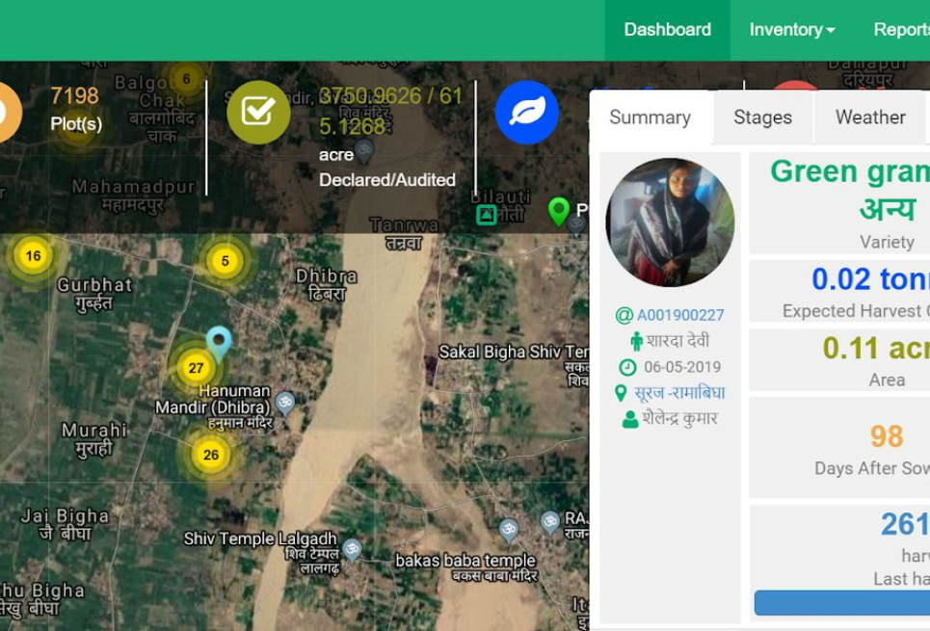
Cropin: Interactive Dashboard
…to view and analyze farm and farmer data

Slide 20
Project: Mid-Term Learning
Adoption: 90 per cent of farmers reported following the advice after it was received. Adoption (Non-Compliance): Lack of understanding of advisory / changed numbers / lack of availability of pesticides or fertilizers recommended
Alerts raised are low: where raised was on pest and disease attack (substitute/validating pesticide shopkeeper advice)
Indirect Benefit: Farm plot measure accurately by geo-audit is 5 to 10% smaller than assumed by the land owner. Farmers used to end up buying more pesticides and fertilizers than was needed; a practice now avoided.
POP: Farmers are willing to adopt new practices where nudged by both SMSs and Community Resource Persons
Women-targeted approach has significant take-up

Slide 21
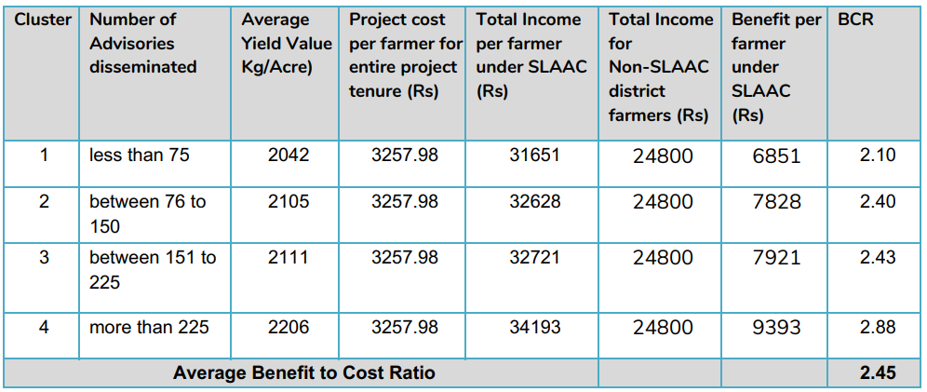
Benefit Cost Analysis
Per Farmer Per Season
INR 630 (USD 9)
13% Capex (Forecasting and Cropin Platform)
87 % Opex (Human Resources)
Source: Cropin Case Study, March 2019

Slide 22
Learning and Way Ahead for Rural Advisory Services

Slide 23

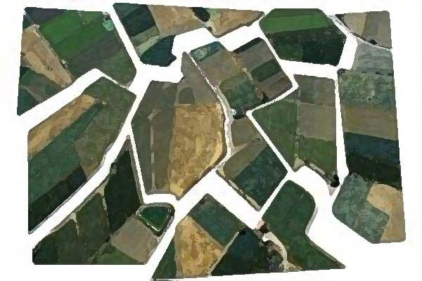

The broader challenges remain…
  Fragmented Data and related data acquisition costs: What role does the Government play?
Majority small and marginal farmers, slower pace of digital adoption: value (pilot – large farmers) over volumes (scale-up)?
  Urban digital entrepreneur – rural farmer: bridging the gap

Slide 24
The Future: Increasing Productivity through Advisory Services
Evolving Revenue Models: Farmer pays?
Building Data Platforms
Localisation
Appropriate Infomediaries
Bundled Products
Multiple Channel Access Points

Slide 25
Thanks

